Slide 1


BANKING ANALYSIS OF MARKETING
TEAM D ​
Lasya Tlv​
Sangeetha D​
Santhosh. J​
Shifana Tasneem M​

Slide 2

OBJECTIVES
The idea is to check and evaluate the client's/ customer who often has more in term subscriptions.
The main motive in the banking data is to analyze the hidden interference and targeting results.
Term deposits grabs the bank to devise their target customers and better channelize their marketing efforts.

Slide 3
ARCHITECTURE
Visualization Grafana
Data Source: CSV
Data Ingestion: Spark Shell
Data Processing: Spark SQL Machine Learning
Data Storage : PySpark

Slide 4
TECHNICAL SPECIFICATIONS
Data set: Bank-full.csv
Data computation and Analysis: SQL, Machine learning
Data storage : PySpark
File formats: CSV
Data ingestion: Spark shell
Data cleansing and scrubbing: spark
ETL: Spark
Visualization: Grafana
Language : Python

Slide 5
INGESTION AND PREPARATION ON WORKFLOW
Load the CSV file to local using wget command
Data frame created in pyspark
Cleansing, Scrubbing and removing unwanted records from the table
Dropping columns with null values
Performing Sort operation in bank dataset file
Applying possible Transformation on data frames
Performing partition of particular column
Implementing Pyspark dataframe to Mysql and performing operations
Integration from Mysql to Grafana

Slide 6
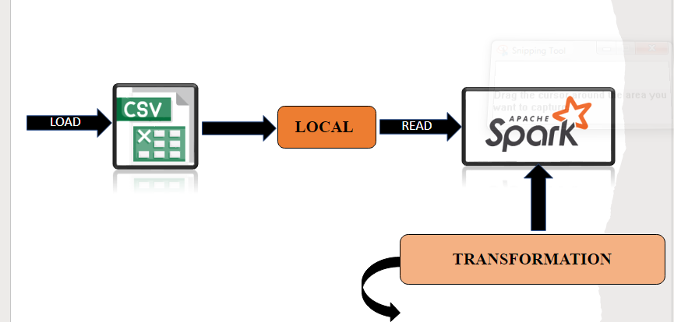
WORKFLOW 1

Slide 7
TRANSFORMATIONS ON DATAFRAME
Spark Transformation is a function that produces new Data Frame from the existing DataFrame.
We applied "GroupBy" to count the means of education, job, y, age.
'Filter' method to assign the value of housing, loan, default with yes as 1 and no as 0.
Using ‘agg’ to find the Mean of Max and Min age of the targeted customer.

Slide 8
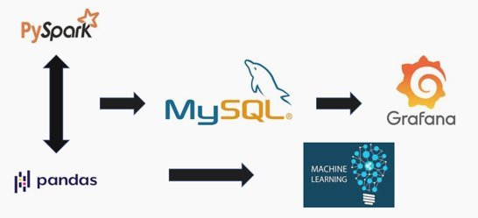
WORKFLOW 2

Slide 9
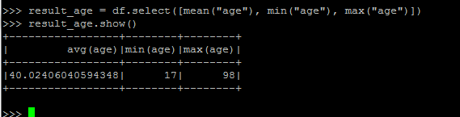


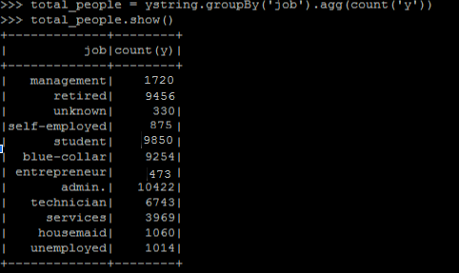
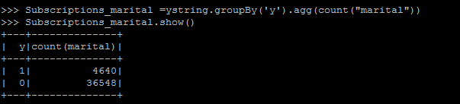
Analysis

Slide 10
BUSINESS QUERIES:
1. Are retired people more likely to subscribe for term deposits? ( maybe they prefer safe investments)​
No. The number of Subscriptions by retired people are moderate. But we can see a positive result of the campaign on senior people. That is the proportion of yes/no is more for retired people.​
Similarly, it is also interesting to see a very positive effect of the marketing campaign on students.​
​
2. Do salaried people prefer it more than business owners who would invest money into their business rather than putting it in the bank?​
Yes. Salaried People (admin, service, technician, blue collar jobs etc.) are much more interested than entrepreneurs and self-employed people.​

Slide 11
BUSINESS QUERIES:
3. Are married people more likely to subscribe for term deposits? (They may prefer having savings for their children?)
No, Proportion of single subscribers is more than 3%.
4. If you already have loans, would you be less likely to subscribe to term deposits?
Obs→ People having personal loans subscribe less to the term deposits. The same is not true for people with home loans.
5. Are younger customers more likely to subscribe to a term deposit compared to old customers (age>60) ?
It looks like effect of marketing on old people is much more positive than corresponding effect on young people! So old people can be a major group we would like to target!

Slide 12
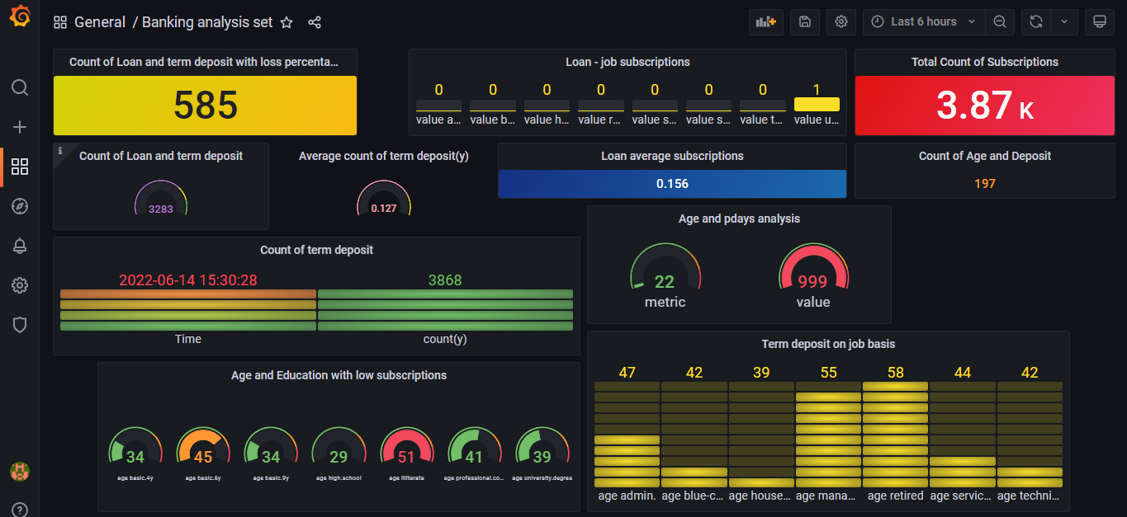
DATA VISUALIZATION

Slide 13
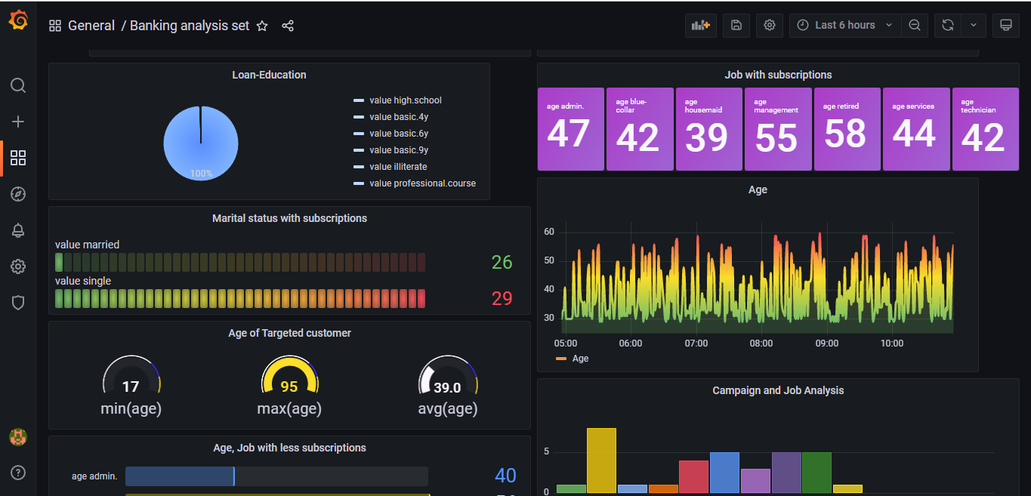
DATA VISUALIZATION

Slide 14


